Slide 1
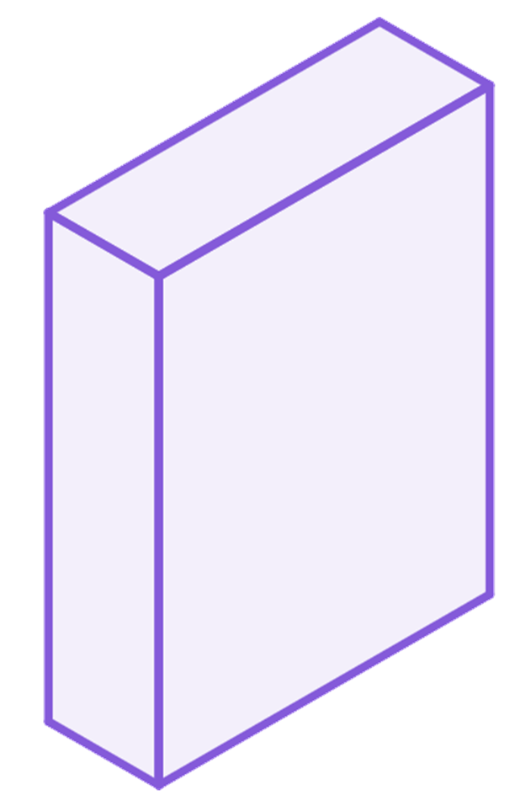
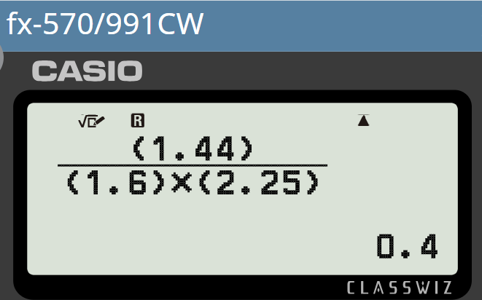
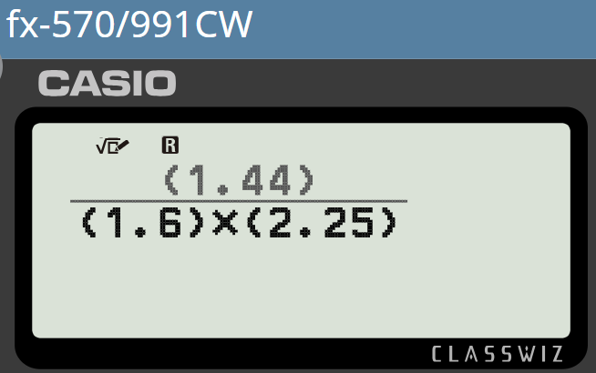
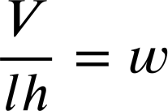
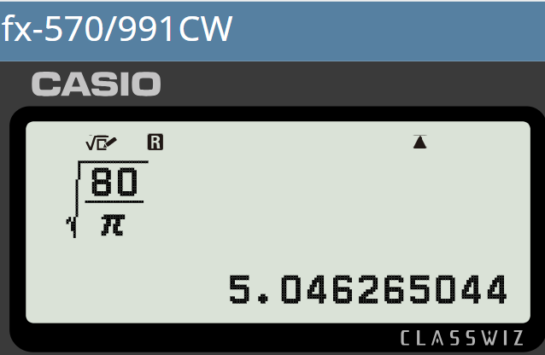
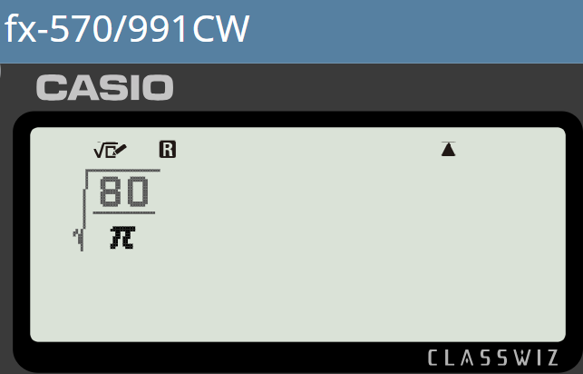
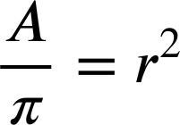
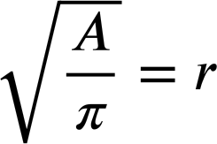
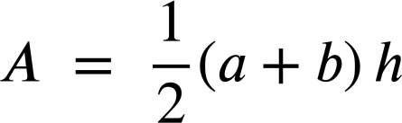
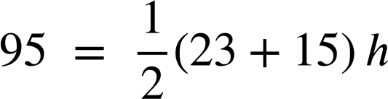
Evaluating expressions without changing the subject
Task A: Rearranging in order to solve
1) The formula for volume of a cuboid can be written as V = lwh
Rearrange the formula to make w the subject. Then evaluate to find the width of a cuboid with length 1.6 cm, height 2.25 cm, and volume 1.44 cm²
V = lwh
h
w = 0.4 cm
w
l
2) The formula for the area of a circle is A = πr²
Rearrange the formula to make r the subject. Then evaluate to find the radius of a circle with area 80 cm²
A = πr²
r
r = 5.05 cm (to 2 d.p.)
Task B: Evaluating without changing the subject
1) Missing dimensions in a trapezium.
b
a) A trapezium has area 95 cm², a lower base length of 23 cm and an upper base length of 15 cm
h
Substitute without rearranging to find the height (h).
a
95 = 19h
h = 5 cm

Slide 2
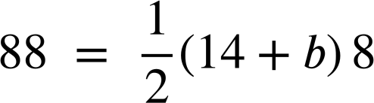
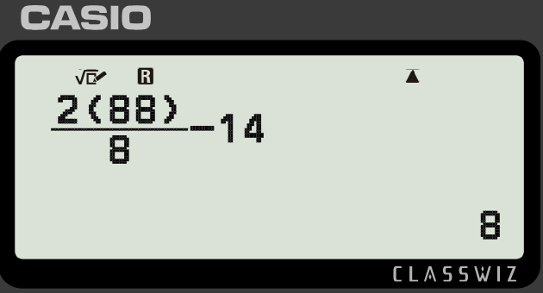

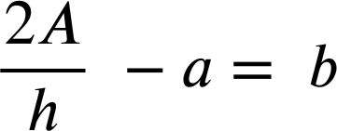

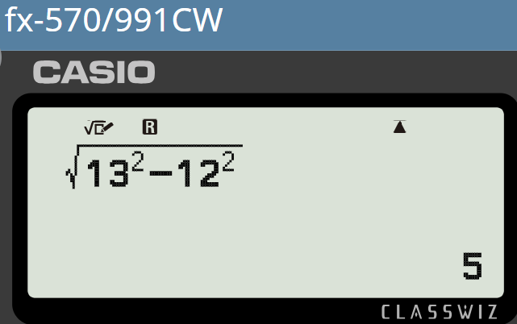



Evaluating expressions without changing the subject
b) A trapezium has area 88 cm², a lower base length of 14 cm and a height of 8 cm
b
h
Substitute without rearranging to find the upper base (b).
a
An alternative method would be to rearrange the formula to make b the subject…
88 = 56 + 4b
…and substitute.
32 = 4b
b = 8 cm
c) Compare the approaches in parts a) and b)
Part (b) was the harder problem. It had more steps and involved more skills, therefore more opportunities to make an error.
2) A right triangle has hypotenuse 13 cm, and one shorter length of 12 cm
a) Substitute and evaluate without rearranging to find the remaining shorter length.
c
a² + 12² = 13²
a
a² = 13² − 12²
b
a² = 169 − 144
a² = 25
a = 5 cm
b) Rearrange to make a the subject, then substitute to find the remaining shorter length.
a = 5 cm
c) Compare the approaches in parts a) and b)
There’s a lot of similarity between the two methods. They give us the same result with a similar level of effort in this problem.
Mathematics in Education and Industry
v2.3

